Slide 1


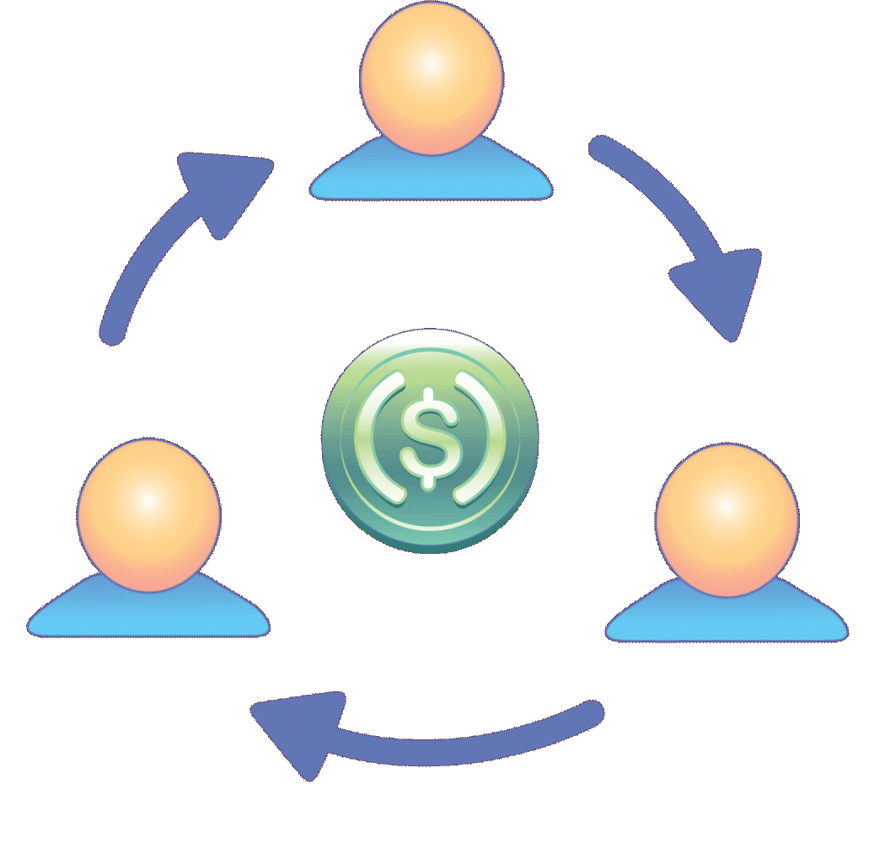
FINANCIAL MANAGEMENT SYSTEM
Expense Tracking & Analysis Platform
DHANRAJ CHOUDHARY [25BCE10624]
PALAK ROY [25BAI11268]
SHRUTI MISHRA [25BCY10042]
KUMARI LAXMI [25BCY10206]
C SAHASRA LAKSHMI [25BCY10241]

Slide 2


The Financial Blind Spot: Why We Need a Digital Money Notebook?
Current Financial Management Challenges:-
Lack of real-time expense visibility and tracking mechanisms
Inadequate categorization leading to unclear spending patterns
Manual tracking methods prone to human error and inconsistency
Limited analytical capabilities for informed decision making
Poor integration between income tracking and expense management
Our app provides the essential, easy-to-use digital solution needed to replace scattered receipts and complex spreadsheets, delivering clarity, control, and confidence over personal finances.

Slide 3



TRACK INCOME AND EXPENSES DIGITALLY
Comprehensive Financial Management Platform
What it does?
1. Real-time transaction recording with automated validation
2. Dynamic categorization system with customizable parameters
3. Advanced analytics engine for trend identification
4. Persistent data storage with reliable retrieval mechanisms
5. Intuitive user interface optimized for daily usage patterns
Benefits:
Easy-to-use
Provides Insights
Helps Save Money

Slide 4
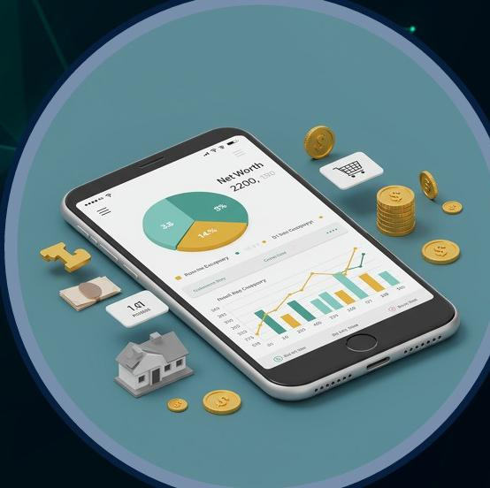
KEY FEATURES OF OUR PROJECT
1. Transaction Input and Management (Core Functionality)
These feature focus on the efficient capture and editing of the financial data.
2.Organization and Tracking
These features define how data is structured and categorized for easy analysis.
3.Analysis, Reporting, and Storage
These features provide deep insights and ensure data persistence and accessibility.

Slide 5







TECHNICAL IMPLEMENTATION
DEVELOPMENT STACK & ARCHITECTURE
CORE LANGUAGE
INTERFACE LAYER
Python 3.x
CLI-Based System
DATA STORAGE
DEVELOPMENT ENVIRONMENT
JSON File System
VS Code / PyCharm
DEVELOPMENT METHODOLOGY
Agile development with iterative feature implementation
Modular architecture ensuring scalability and maintainability
Test-driven development for robust error handling
Version control integration for collaborative development
Scalability Path: Foundation designed for future web/mobile platform migration

Slide 6


Team Structure&Project Timeline
Team roles have been allocated as follows:
Team Member 1: User Interface (UI) and Input Handling
Team Member 2: Development of Core Transaction Functions
Team Member 3: Creation of Reports and execution of Data Analysis
Team Member 4: Management of File Handling and Data Storage
Team Member 5: Oversight of Testing and overall Project Coordination
Breakdown:
• Week 1-2: Learn Python basics & project planning
• Week 3-4: Build core functionality
• Week 5-6: Add advanced features & reports
• Week 7-8: Testing, debugging, documentation

Slide 7

THANK YOU!

